Slide 1

CS554 Final Project
Group member
Zehui Zhao Huijun Sun Yunxiang Fu Shiwei Ding

Slide 2
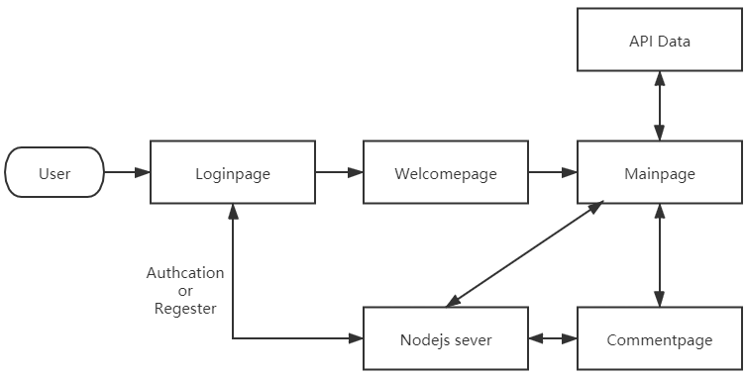
Design frame

Slide 3
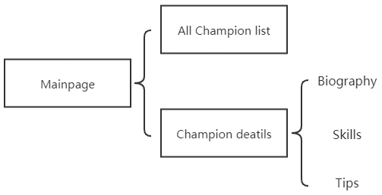
Main Page Block

Slide 4

Using Technique
Sever: node.js + express sever, mongoDB database, redis
Front - frame: React App + typescript
Animation transformation: GSap (GreenSock Animation Platform)
Extra – technique: Nodemailer

Slide 5

Project presentation

Slide 6

Login Page
Login page two part:
Left sign up, require username, email and password
Right sign in, require username and password
Sign up success get into welcome page, failed will see register fail alert, stop here
Sign in success get into welcome page, failed will see login failed alert, stop here

Slide 7
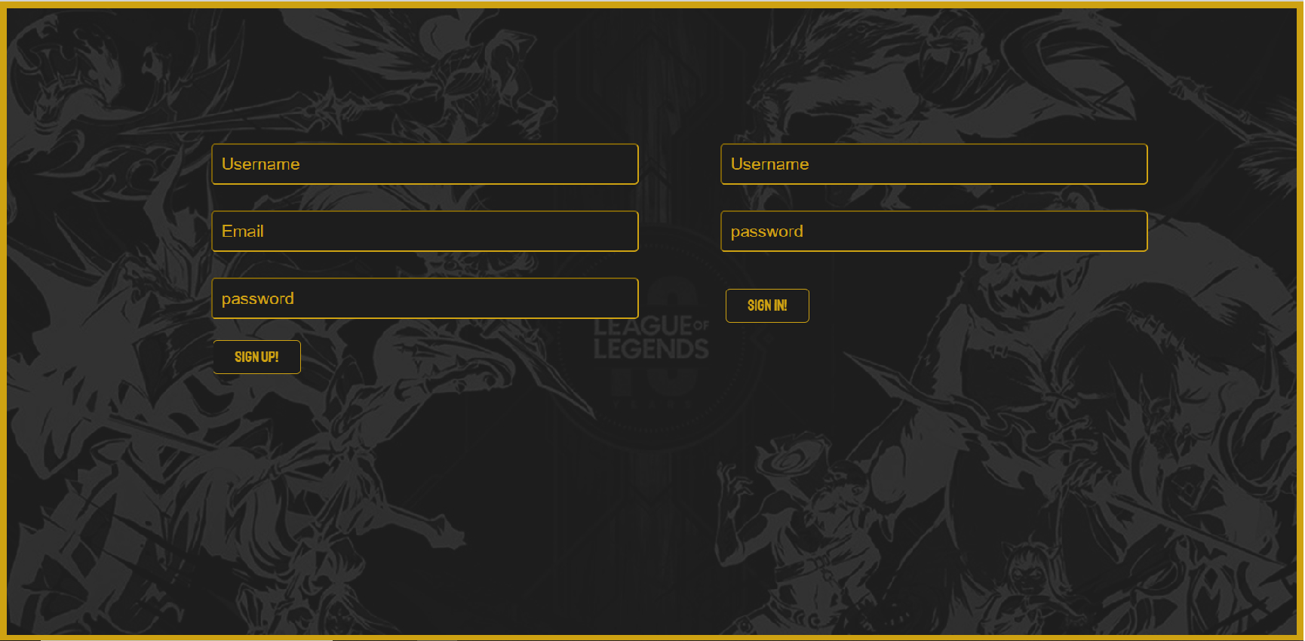
Login Page show

Slide 8
Main Page
Main Page two part:
Top: Main header, place search box, user reviews and user comments button
Bottom: Main container, place each Champion which fetch from API, link to
each Champion individual pages.

Slide 9
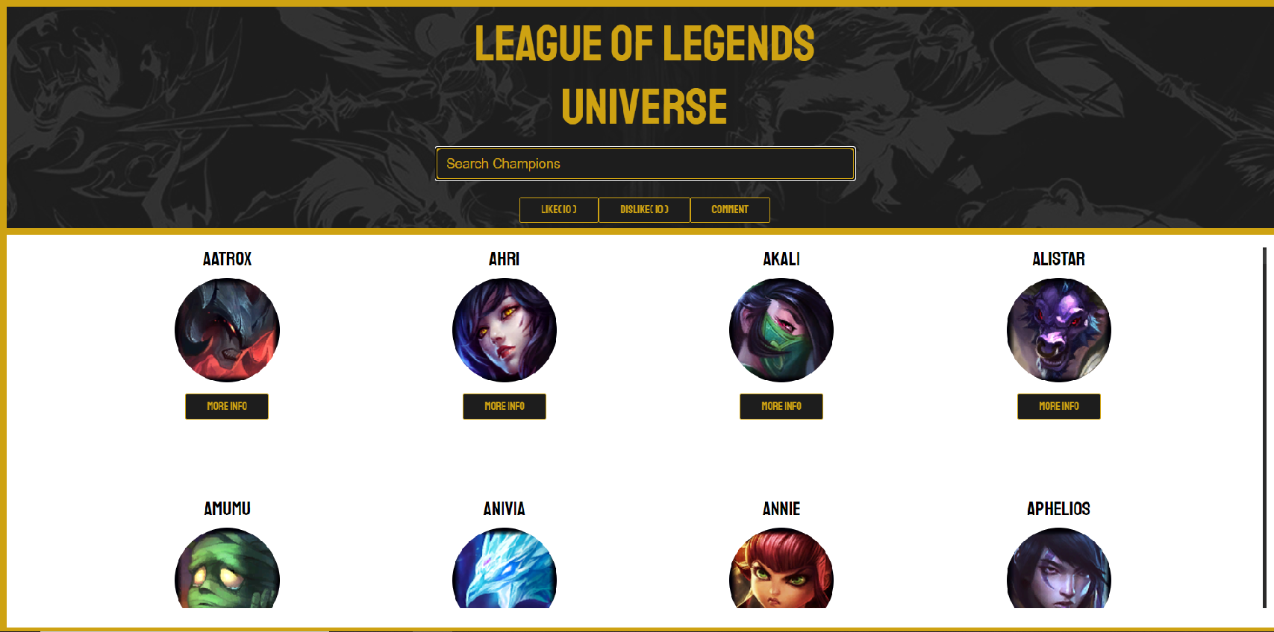
Main Page show

Slide 10
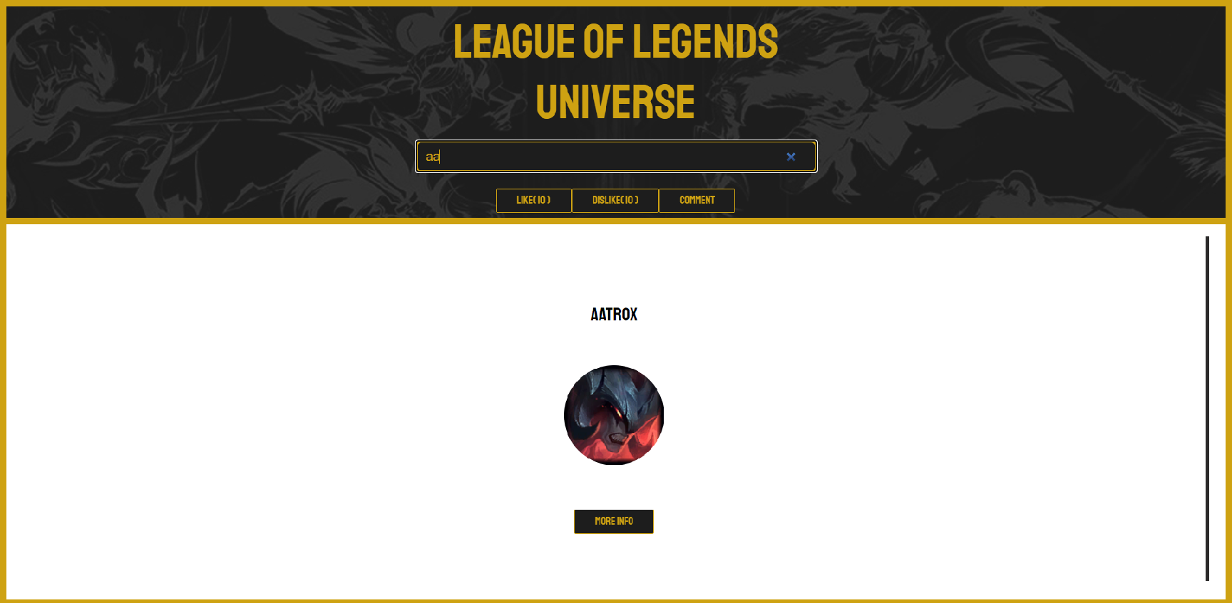
Search Box show

Slide 11
Champion Page
Champion pages are not use independent router, we use Gsap to hidden the main page, show the champion pages for each Champion.
Details for a Champion is hidden in the bottom, click the arrow button to see it. This part also use Gsap to control it.

Slide 12

Champion Page show

Slide 13
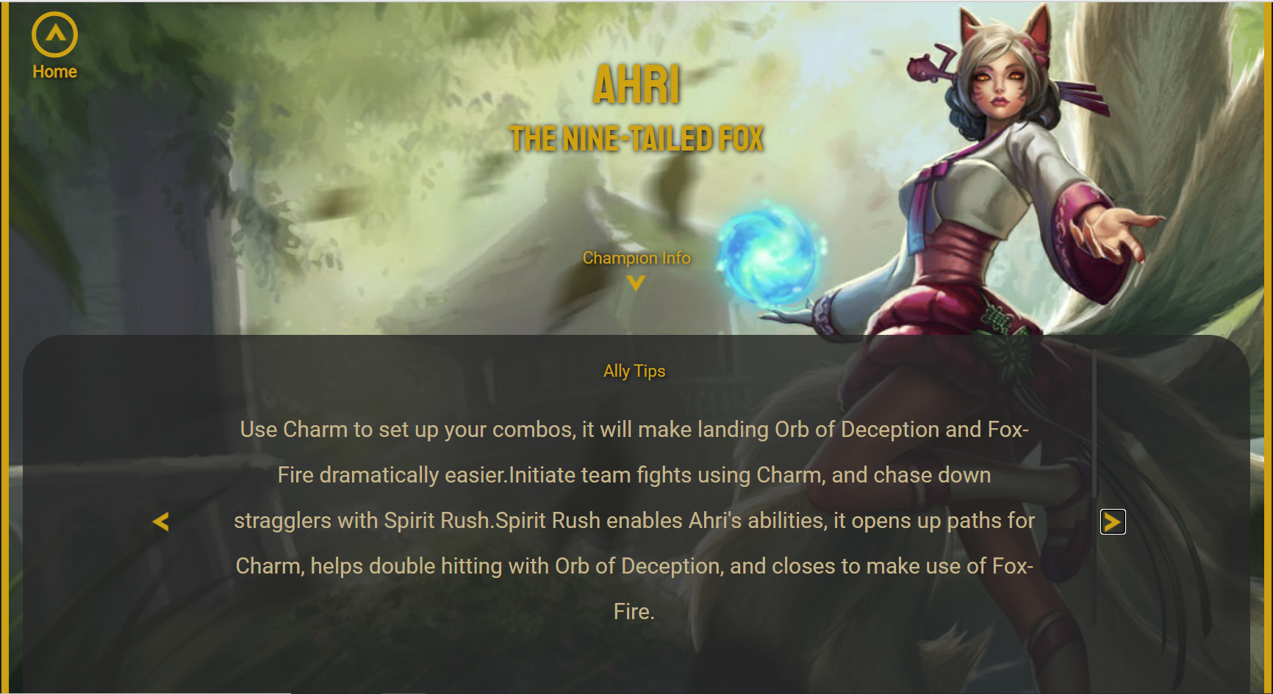
Champion Page show

Slide 14
Comment Page
Comment Page provide user to send their comment to our website, the title and context of the comment cannot be null
User also can see all comments in previous, click the “SHOW PREVIOUS COMMENT” button to show it.

Slide 15
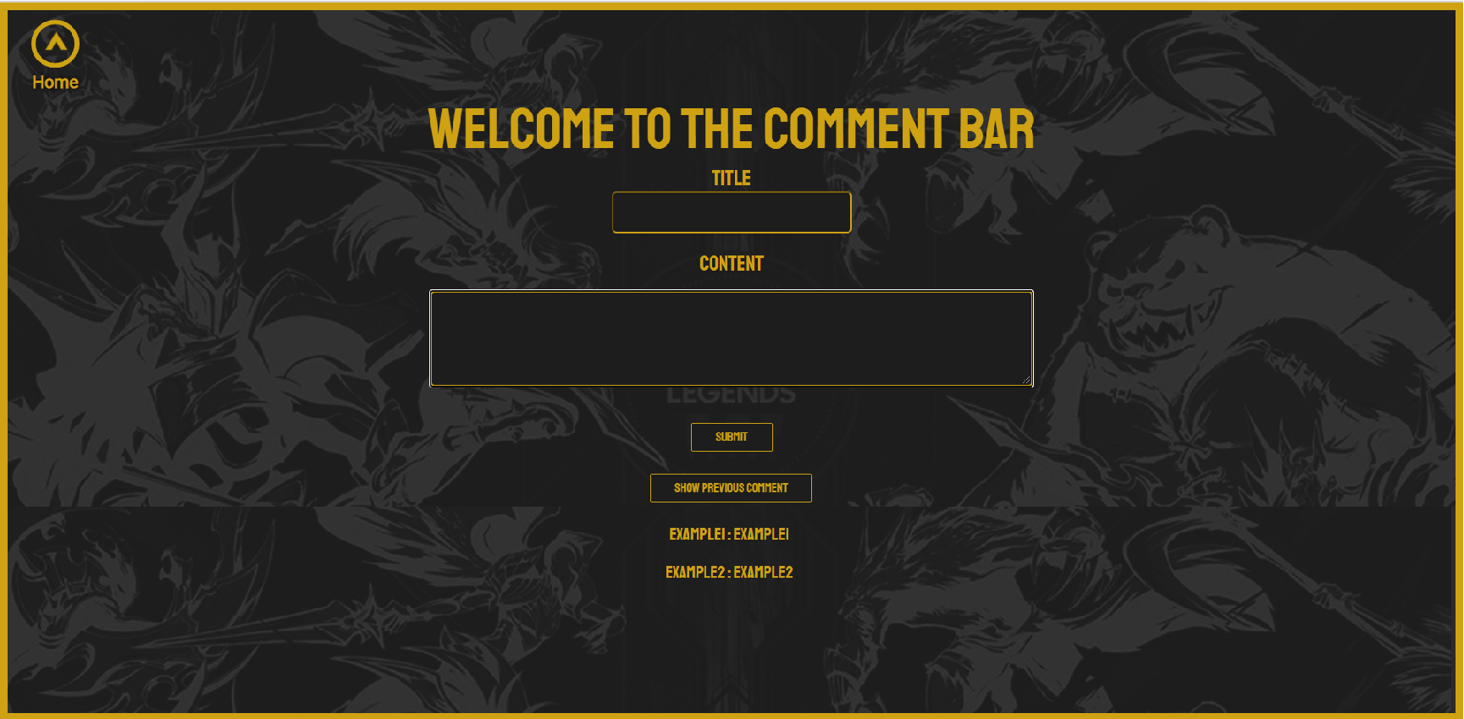
Comment Page

Slide 16
Course Technologies Used
React
React is an UI component library. The UI components are created with React using JavaScript, not a special template language. This approach is called creating composable UIs, and it’s fundamental to React’ s philosophy. React UI components are highly self-contained, concern-specific blocks of functionality.
Typescript
TypeScript is an open-source programming language developed by Microsoft that is a superset of JavaScript in order to provide a great deal of syntactical sugar.
Redis
Redis is an in-memory data structure store. Redis is often used as a high-performing lookup. Reads and write operations are extremely fast.

Slide 17
Independent Technologies Used
Nodemailer:
Nodemailer is a module for Node.js applications to allow easy as cake email sending. The project got started back in 2010 when there was no sane option to send email messages, today it is the solution most Node.js users turn to by default.
GSAP:
The GreenSock Animation Platform (GSAP) is an industry standard JavaScript animation library from GreenSock that lets you craft high-performance animations that work in every major browser.
The GSAP animates anything JavaScript can touch (CSS properties, SVG, React, canvas, generic objects, whatever) and solves countless browser inconsistencies, all with blazing speed (up to 20x faster than jQuery).

